Slide 1
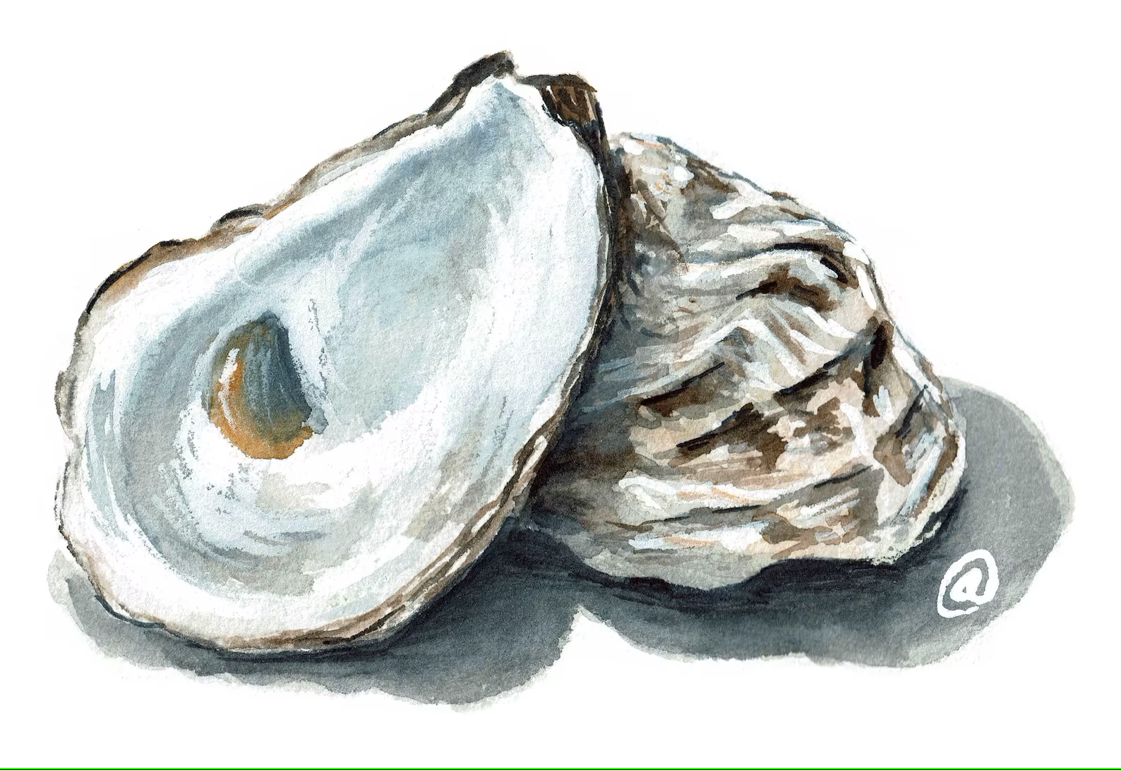
pearls from James chapter 1
when troubles come your way, consider it an opportunity
If you need wisdom, ask
God blesses those who patiently endure testing and temptation
Notes:
Accepting Jesus as Lord and Saviour is significant for how we approach life. As Saviour we believe Jesus has assured our eternal fate. As our Lord we acknowledge Jesus as the one who will lead us through the life we now have.
In James’ letter to the early Christians he is reflecting on the Lordship aspect of our relationship with Jesus. In James we learn of the issues that arose in their day to day lives, and how having Jesus as Lord, influenced how they lived in community with fellow believers and as the church welcomed new believers.
James is a practical book with significant instruction to view the world from a new perspective. In Chapter 1, James gives his first advice on how to view life as a believer in Christ.
Dear brothers and sisters, when troubles of any kind come your way, consider it an opportunity for great joy. For when your faith is tested, your endurance grows… and when it is fully developed, you will be perfect and complete, needing nothing.
And
If you need wisdom, ask our generous God, and he will give it to you.
So, the first thing we should think, when a trial comes up is,
“God says this is an opportunity to become more mature in faith.”
And then,
“Lord, I want you with me in this, please guide me through.”
This approach is more than positive thinking, it’s the mindset we take when we take Jesus as our Saviour. We trust he has our back, and even our trials will work out for our good.
What is your natural tendency when trials come your way?
As we mature, and learn to see things with God’s perspective we tap into a great way to think and a great source of wisdom.

Slide 2
pearls from James chapter 2
The Church is egalitarian in nature
Galatians 3:28
Ephesians 2:14
Colossians 3:11
Notes:
In Chapter 2 James introduces the topic of ‘showing favourtism’ or unfair partiality, or pandering.
From our reading,
James describes what was happening in some churches when wealthy people come to worship and find out about Jesus. Evidently, the better dressed you were, the better seat you got. James calls out this activity as having wrong motives. (judges with evil thoughts, NIV)
Vs 2-4- suppose someone comes into your meeting dressed in fancy clothes and expensive jewelry, and another comes in who is poor and dressed in shabby clothes. If you give special attention and a good seat to the rich person, but you say to the poor one, ‘stand over there, or sit on the floor.’ – well, doesn’t this discrimination show that you are guided by wrong motives?
What was the wrong motive here? Showing favourtism to people who had wealth over people less affluent. Pandering to wealthy people, perhaps to fatten the bank account for valid ministry. Judas Escariot was of this thinking, wasn’t he?
The new church was to be egalitarian in nature.
In Galatians 3:28 – Paul states, ‘There is neither Jew nor Greek, slave nor free, male nor female, for you are all one in Christ Jesus.’
Eph 2:14 – for Christ himself made peace between Jews and Gentiles by making us all one people.
Col 3:11 – ‘ In this new life, it doesn’t matter if you are a Jew or a Gentile, circumcised or uncircumcised, barbaric, uncivilized, slave or free. Christ is all that matters, and he lives in all of us. ‘
Today, we as Christians can say with hand over heart, ‘ Yes, we hold to the belief that all people are equal and equally loved by God and are welcome in God’s Kingdom. We will not show favoritism.’
However, trying to insure equality in a culturally diverse community is a lot more complicated than you might imagine.

Slide 3
pearls from James chapter 2
The Church is egalitarian in nature
Galatians 3:28
Ephesians 2:14
Colossians 3:11
Our love for each other is our witness
Genesis 12
John 10:16 , 13:35
Notes:
God foresaw there would be a problem at the early church bar-b-ques.
He said, ‘Peter, you won’t understand this now, but you can kill and eat any of the animals you want.’ Peter said, ‘No Lord, I have never eaten anything our Jewish laws have declared impure and unclean.’
But God confirmed 3 times - that the Gentile Christians could bring their pork and basting sauce and it was perfectly fine for the Jewish Christians to smack their lips and enjoy.
Jesus had told them that being adopted into a family with all sorts would be difficult. But James reminds us, ‘Look at the difficulty as an opportunity. Call on my name, just ask, and I will send the my helper to assist you, I will give you wisdom through conflicts and trials.
It was actually God’s plan to put his family through these cultural trials.
Genesis 12: God told Abraham that his decendants would be come a blessing to all nations.
Jesus in John 10:16 – ‘I have other sheep, too, that are not in this sheepfold. I must bring them also, and they will listen to my voice; and there will be one flock with one shepherd.’
Jesus said, They will know you are Christians, when they see how you are able to get along with one another. (John 13:35)

Slide 4
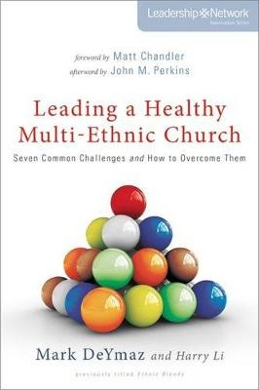
Changes in Church context
The first century church was encouraged to create an environment in which diverse people not only felt welcome but also, in time, felt they were a significant part of the whole.
…will require us to be patient with genuine seekers – those new to the faith and those disenfranchised who are reconnecting with Christ and his church after a season of sin, hurt, or absence.
Notes:
Changes in Church Context-( DeYmaz, Mark, Leading a Healthy Multi-Ethnic Church)
Societally, in the early 1st C, the church was the one place where social distinctions did not exist.
“There must have been a certain initial awkwardness when master found himself next to his slave in worship or even being taught by his slave in worship.’
Today, the church can be a very segregated place. We can all look alike, like the same meat and spices on the bar-b-que, come from the same economic class. In fact modern church movements have been purposefully designed to replicate themselves, planting the same homogenous congregations. Allowing for sheep from other folds hasn’t been considered in many cases.
The first century church was encouraged to create an environment in which diverse people not only felt welcome but also, in time, felt they were a significant part of the whole.
A spirit of inclusion- will require us to be patient with genuine seekers – those new to the faith and those disenfranchised who are reconnecting with Christ and his church after a season of sin, hurt, or absence. Ultimately, the goal is to create an environment where all people feel welcome, where truth is proclaimed, where grace and mercy abound.
But …
Inclusion doesn’t include embracing doctrines or practices that in one way or another violate the Word of God.

Slide 5
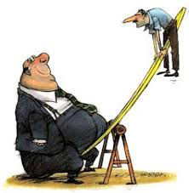
Changes in Church context
How do we become inclusive and not violate the Word of God?
Inclusion doesn’t include embracing doctrines or practices that in one way or another violate the Word of God.
Notes:
But …
Inclusion doesn’t include embracing doctrines or practices that in one way or another violate the Word of God.
So for the church in James’ time, one issue was favoring the wealthy at the expense of the poor. They didn’t have the balance right.
Who do we favour today and who do we short change? Who could we welcome into fellowship today, that might cause us to feel uncomfortable? Or challenge our theology, about what we think is acceptable?
This is where the rubber meets the road, so to speak. This is the space where I see churches struggle. How to you make diverse people welcome and not embrace practices that violate the Word of God? It’s complicated when you really look at it.
The Anglican church recently formed a new denomination, The Diocese of the Southern Cross. The split was over the ordination of women, the blessing of same-sex marriages and more relaxed views regarding divorce. This isn’t new. Bev and I have seen this issue split a supporting church that we have in the States and other churches struggling to find a consensus. One faction interprets the Word in one way and the other faction another.
The Brethren denomination also has it’s factions. Fractures over theology and the implementation of church discipline is in our history. But is this disunity allowable in God’s Church? Well, He is allowing it at present, it seems AND I personally think there is space for honest debate and disagreement in God’s church today.
This has been a personal struggle of mine, but I think James practically helps with this issue in the next six verses of Chapter 2. This issue of how do we welcome those of different flocks and stay true to God’s teaching.
how do I welcome people with humility, and look out for their interests in today’s environment? An environment much different from James and first century church.
How can I, being born into priviledge, by no intention of my own, by being an Anglo, western middle-class male
Welcome diverse ethnic people, people that identify in sexual catergories, females and those in different economic groups into fellowship, how do I welcome them with humility, thinking of their needs above mine?

Slide 6
pearls from James chapter 2
Royal Law
Love your neighbor as yourself (v8)
Philippians 2:3
Rhody Watercolors
Notes:
After describing the current trouble of favourtism, James introduces 2 laws that help us with sorting out troubles like these in the church community.
Royal Law- ‘Yes indeed, it is good when you truly obey our Lord’s royal command found in the Scriptures. “ Love your neighbor as yourself.” v8
How do you love yourself? For me, I put my needs and my families needs right up at the top of the list. When we include our neighbours at the top I guess we are getting close to obeying this Royal law. I’m pretty quick to forgive myself when I mess up. Thinking of others in love, even when their actions or words are unloveabale. The theme of James is putting our faith into action. So I think loving our neighbours is about reaching across the fence to show our care and love in actions.
Phil 2:3 – do nothing from selfishness or empty conceit, but with humility of mind regard one another as more important than yourselves; do not merely look out for your own personal interests, but also for the interests of others”
I don’t think this is easy. We can usually ignore our neighbours today and that is socially acceptable. I don’t think it is acceptable to God. But if we approach loving others, welcoming them as James suggests in Chapter 1 we will consider these relationships as opportunities to grow in our maturity, and God will help us and we will be blessed by our actions.
I believe James is giving us, with the Royal Law, help with our specific societal issues of; racism, sexism, gender diversity and previledge. We start with loving those who are different, with love. Love that Philippians describes. Thinking of them as valued by God, part of the folds he desires.

Slide 7
pearls from James chapter 2
Royal Law
Love your neighbor as yourself (v8)
Philippians 2:3
Law of Mercy (law of love)
Avoiding self-righteous thinking (v9-11)
Demonstrating the mercy you have received (v12,13) Romans 5:8
Rhody Watercolors
Notes:
The last ‘pearl’ James gives us here is in the Law of Mercy or Law of Love in the next verses.
10 And the person who keeps all of the laws except for one is as guilty as the person who has broken all of God’s laws.
11 For the same God who said, “ Do not commit adultery also said, ‘Do not murder.” So if you murder someone, you have broken the entire law, even if you do not commit adultery.
13 For there will be no mercy for you if you have not been merciful to others. But if you have been merciful, then God’s mercy toward you will win out over his judgement against you.
I believe many issues we face today as a church and for myself personally as a Christian, may just fall under this category of ‘favouritism’. We favour ourselves because we see our failings as not as significant as the failings of others. We become self-righteous in our thinking. This is not the way God sees it.
James explains that sin is sin- the ‘big ones’ and ‘little ones” are all the same. When we sin in our little ways, we are no better than the adulterer or murderer. This is quite important. Can we see others and their sins with the mercy God sees ours? That is what He asks us to do. That is what we do when we love our neighbours as ourselves.
Romans 5:8 - Jesus yet while we were sinners did show us mercy by taking the sin of all the world on his shoulders.
Jesus’ act of mercy was a one time transaction but that transaction paid for sins past, present and future for those who trust in Him. Jesus’ mercy has no limit. Mercy is in our DNA as Christians. The stuff that forms us as human is mercy. If you slander us, we respond in mercy, if you slap us we turn the check of mercy, if you steal our coat, we glady let you take it. If you cut us, we bleed mercy.
Mercy overflows. Jesus’ death continues to make humanity right with God. When we make mistakes today by a lack of mercy toward our family or neighbours, we merely go to the fount of mercy. Jesus overflows with mercy. So should we.

Slide 8
Pearls from James
View life challenges as opportunities
Seek God’s wisdom
Engage with our neighbor in love and mercy
Notes:
So how can we reconcile the fact that there doesn’t seem to be much unity in the Church? There are not only multiple denominations that read the scripture differently but different factions within denominations that have different views on how Christians should go about expanding God’s Kingdom. Is there a right and a wrong way to go about it?
Next week we explore faith and action. Perhaps we will find some answers there. But as I have pondered this, I believe God gives His Church the freedom to address these issues without being prescriptive. There is room on the teeter totter to sway a little. The balance is not exact and stationary. It is up to us to wrestle with the issues and act as best we know how in accordance with the Word of God.
Within the verses in James, He gives us these foundational precepts to approach challenges as we seek to be relevant in our times.
View challenges in life as opportunities, to mature, bless others and be blessed in the process
Seek God’s wisdom, through His Word and through the help of our councillor, the Holy Spirit
God’s Kingdom is inclusive and expansive, as we engage with our neighbour, let us do so in love and mercy.
This way of thinking and living is our calling as Christians. It is a huge challenge, but we do it together, with each other and with the help of our Lord. We do it not out of obligation, but we are compelled to it, from the act of mercy and love poured out on us from the Cross.
Amen

